Slide 1


Networking for Big Data Faculty of Data Science, Sapienza University of Rome Academic Year 2020-2021 Phd Student Davide Aureli
Laboratory Session, NETWORKING for BIG DATA
Prof. Antonio Cianfrani and Prof. Andrea Baiocchi
Speaker: Dr. Davide Aureli
E-mail: davide.aureli@uniroma1.it

Slide 2
Network Traffic Analysis

Slide 3

Lecturer

Slide 4
Course Organization
These Lab sessions can be divided in two typologies:
Lecture and code all together
Final Project Work

Slide 5
General Information
We strongly suggest you to follow the lectures with your laptop.
Every time we will observe some code part, it is better that you will try to reimplement each chunk of the notebook,
this is the only way to become more confident.

Slide 6


Group Project (HOW ?)
Group Rule: It is possible to use the groups formed with Prof. Baiocchi
Presentation: each group will present the work (15 mins), preparing a set of slides to comment the results

Slide 7


Group Project (WHEN ?)
All groups will have the possibility to work exploiting lesson time
During the working time in class you can ask every questions or clarification

Slide 8
IMPORTANT: Group Composition
Please, send just one email for each group to davide.aureli@uniroma1
With all the names of the teammates.

Slide 9
IMPORTANT: Deadline
The project will start during class hour, and everything that remains uncomplete will be finished by July.
The oral exam will be scheduled all together with Prof. Cianfrani

Slide 10





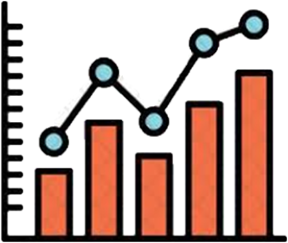
Brain Storming

Slide 11

Road Map
Lecture 3
Lecture 2
Lecture 1
Project

Slide 12
Course Topics
1) Wireshark
2) PyShark
3) Machine Learning (ML) with traffic data

Slide 13
Wireshark – Lecture 1

Slide 14

From Theory to Practice
Until now you have received a complete explanation about Networking Fundamentals
Now it’s time to implement something from scratch

Slide 15

From Theory to Practice
Which kind of projects ?
How a Data Scientist may contribute with his knowledge ?

Slide 16
What is Wireshark ?
Wireshark is a network packet/control analyzer, available for UNIX and Windows.
Protocol analyzer that listens to the network, analyzing the data in transit, highlighting the peculiarities.

Slide 17
Intended Purposes
Observing the different analysis made within Wireshark, we take the inspiration to implement something similar for our own ML Project.
But now let’s start to install Wireshark !

Slide 18
Installation
Under Windows: https://www.wireshark.org/docs/wsug_html_chunked/ChBuildInstallWinInstall.html
Under macOS: https://www.wireshark.org/docs/wsug_html_chunked/ChBuildInstallWinInstall.html
Under Unix:
https://www.wireshark.org/docs/wsug_html_chunked/ChBuildInstallUnixBuild.html

Slide 19
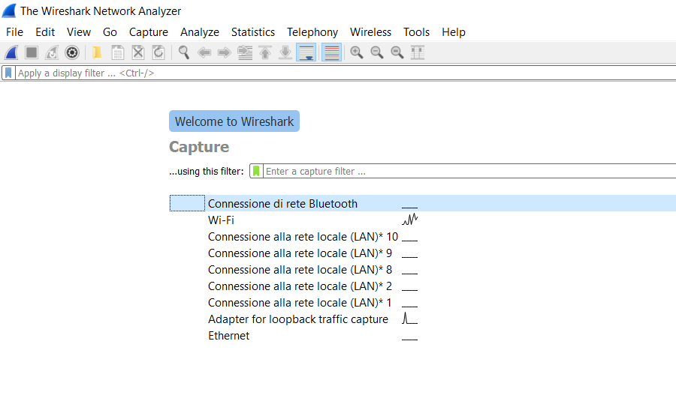
At first glance
Specify the network interface
on which to activate the capture

Slide 20
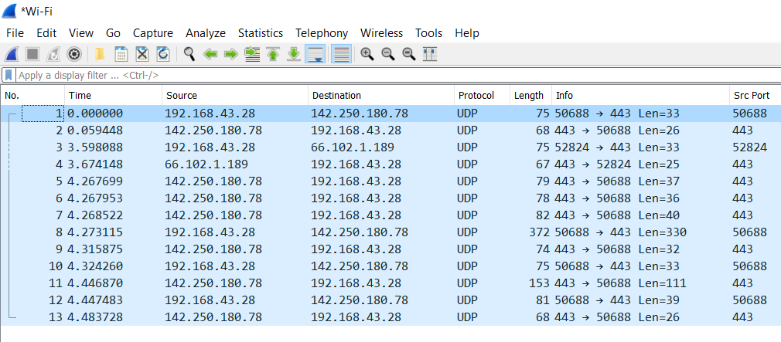
First analysis

Slide 21
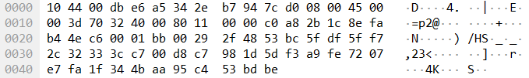
First analysis

Slide 22
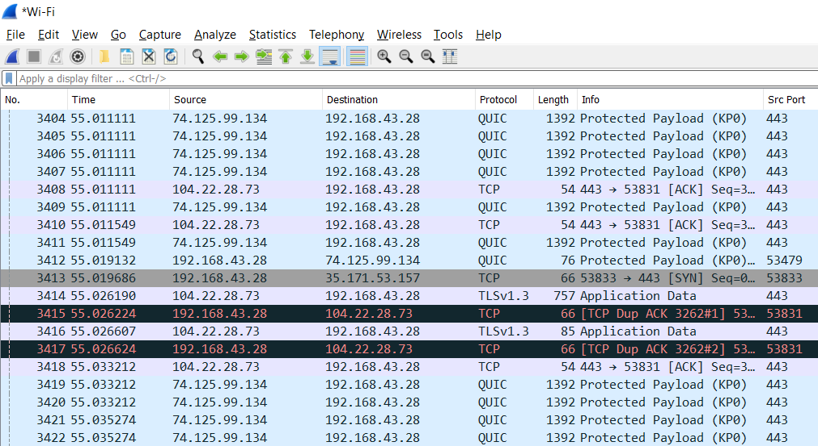
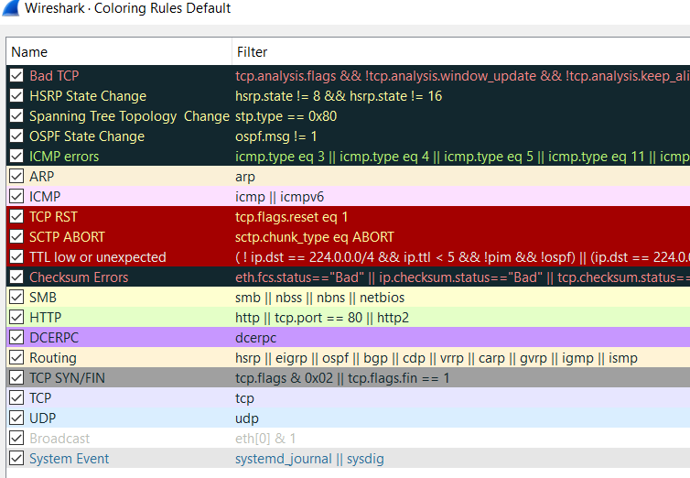
As many colors as rules
Click on → VIEW → COLORING RULES …
**We can also custumized them

Slide 23
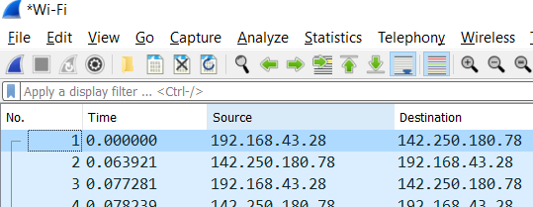
Filtering sniffed trace
Here we can apply different filters written with a precise format
(as an SQL query)

Slide 24
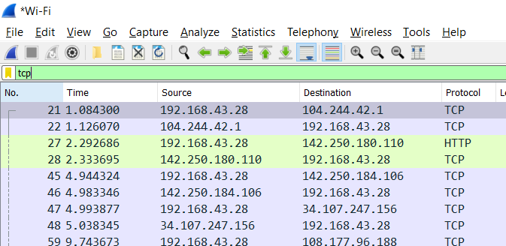
Filtering sniffed trace

Slide 25
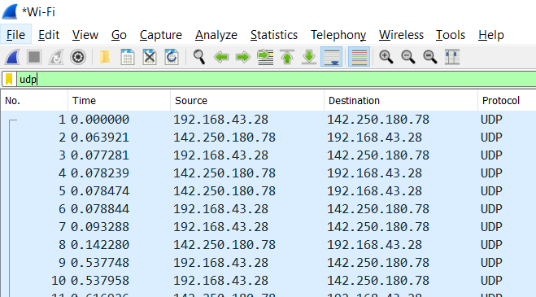
Filtering sniffed trace

Slide 26
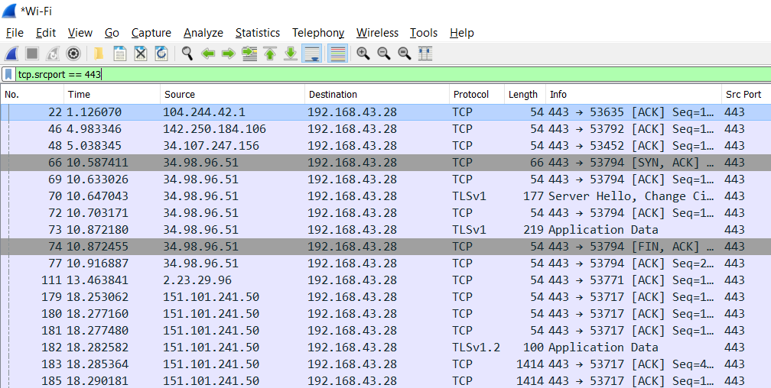
Filtering sniffed trace

Slide 27
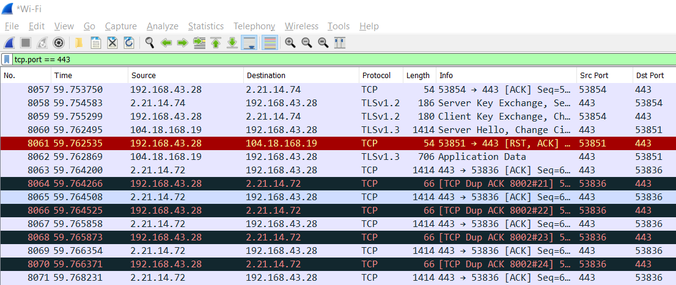
Filtering sniffed trace

Slide 28
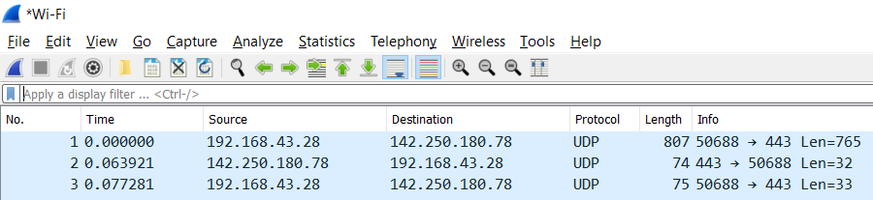
Statistics
Every time we talk about data our beloved statistics comes out

Slide 29
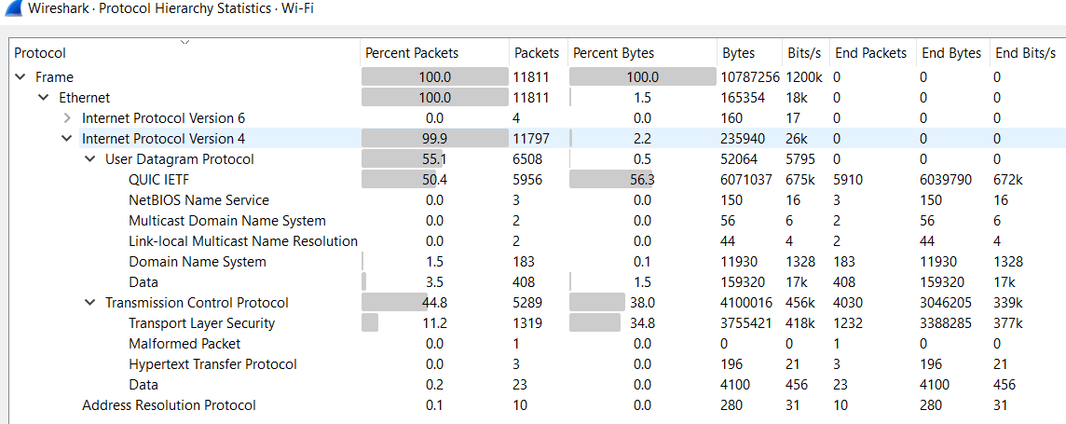
Statistics → Protocol Hierarchy

Slide 30
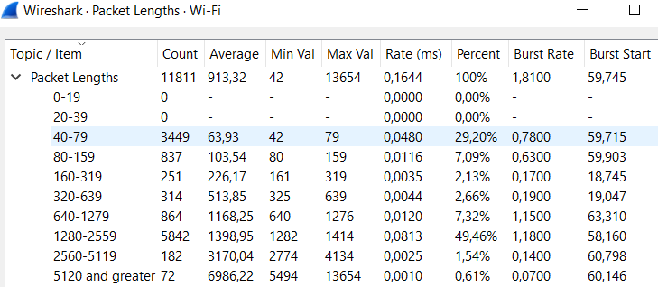
Statistics → Packet Lengths

Slide 31
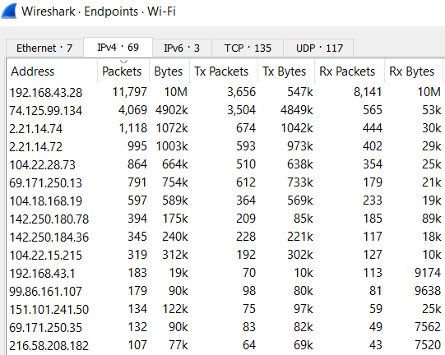
Statistics → Endpoints

Slide 32
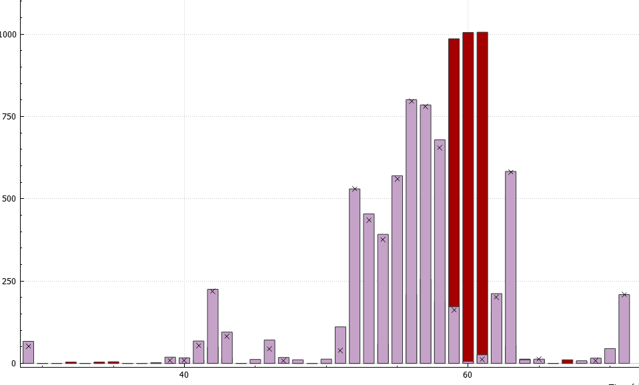
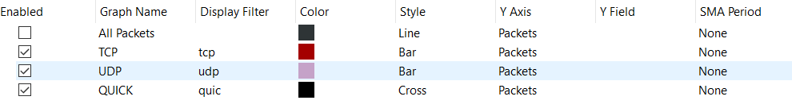
Statistics → I/O Graphs
Pkt/sec
Time(sec)

Slide 33
.pcap file
If we want to save our Packet-CAPture to reuse another time we need to save it in a pcap format.
Now, every time you will hear someone to talk about pcap file you’ll recognize it.

Slide 34
Pyshark – Lecture 2

Slide 35
Until now we have seen different tools provided by Wireshark, but at the same time we lose some degree of freedom.
Our idea is to investigate an alternative methodology to work with the same type of data but reaching similar results, and at the end build our own challenge.

Slide 36
“ Hello Pyshark”
Pyshark is a Python wrapper for tshark, allowing python packet parsing using wireshark dissectors.
This package allows parsing from a capture file or a live capture, using all wireshark dissectors you have installed. Tested on windows/linux.
*Reference : http://kiminewt.github.io/pyshark/

Slide 37

Installation
Follow this GitHub to install Pyshark: https://github.com/KimiNewt/pyshark/
Now we’ll go on using the programming language Python 3.
If you want to go deeper studying a valid alternative to pyshark it is suggested to see Scapy (https://scapy.readthedocs.io/en/latest/)

Slide 38
Let’s start from .pcap file
We can retrieve the pcap file saved from the last session with Wireshark and try to read our trace through Python.
*ReadPcap File
Capinfo different options
Editcap different options

Slide 39
Capinfo
Capinfos is a program that reads one or more capture files and returns some or all available statistics (infos) in one of two types of output formats: long or table.
Reference: https://www.wireshark.org/docs/man-pages/capinfos.html

Slide 40
Editcap
Editcap is a program that reads some or all of the captured packets from the infile, optionally converts them in various ways and writes the resulting packets to the capture outfile (or outfiles).
Reference: https://www.wireshark.org/docs/man-pages/editcap.html

Slide 41
Coding Part
The first coding part will show you how to extract all infos from a pcap file and split it according to time or number of packets.
Code Link : …

Slide 42
Extraction Field
In this coding part we will use for the first time “pyshark”, and it provides the possibility to gather info from the header.
Code Link : …
This link provides the complete code so both for the field extraction and for the statistical analysis.

Slide 43
Statistical Analysis
Creating Dataframe
IP analysis (top sender and receiver)
BitRate different sampling metrics
GeoLocal referenciation for IP addresses
Analysis flows based

Slide 44
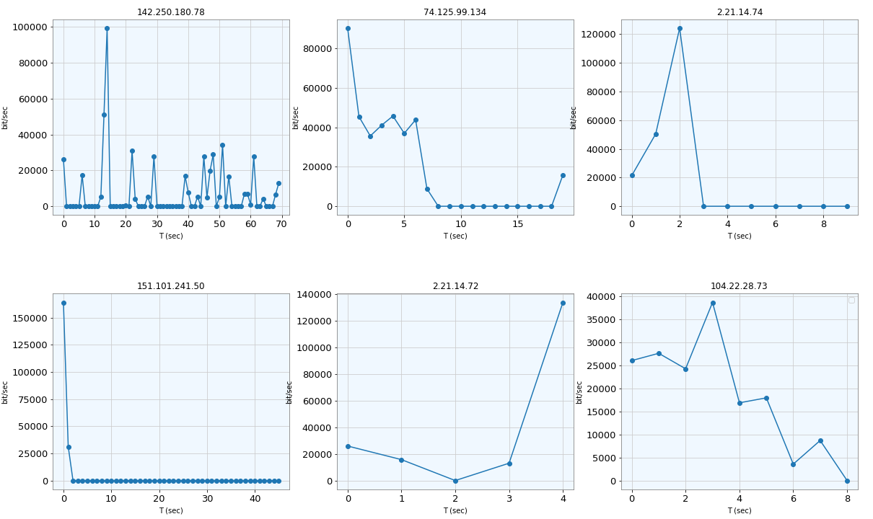
Top Receiver from My IP 192.168.43.28

Slide 45
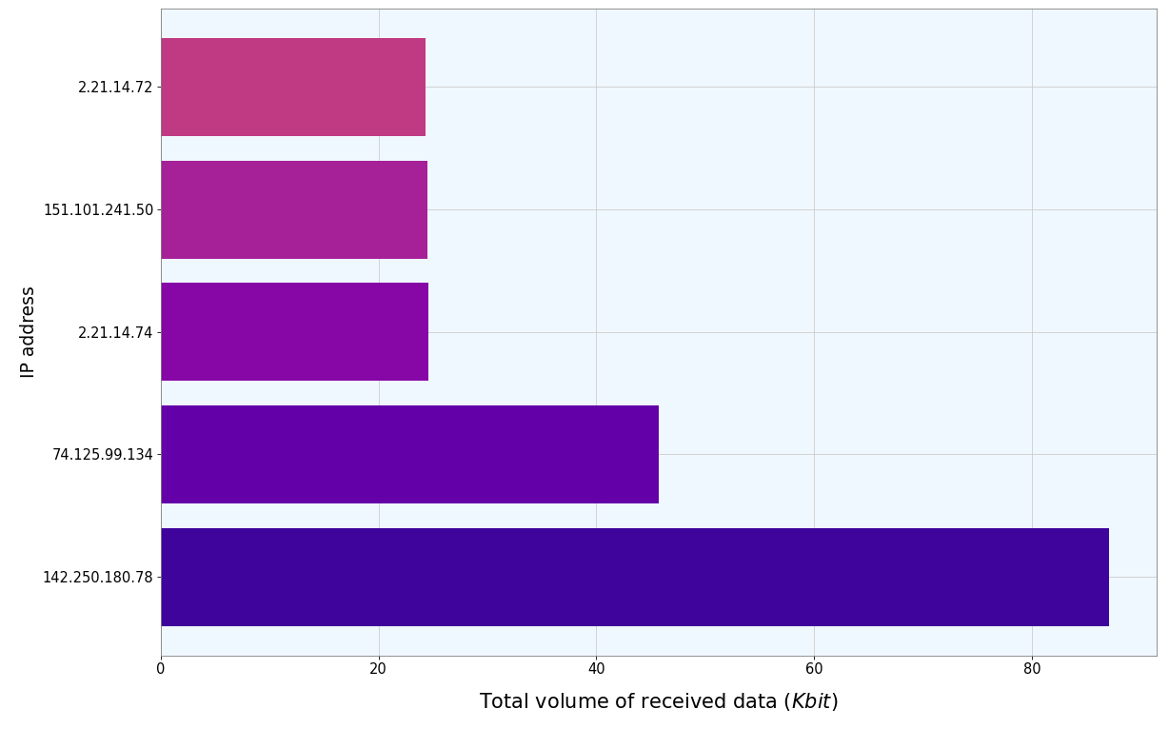
Top 5 Destination for Received Data (excluding My IP)

Slide 46
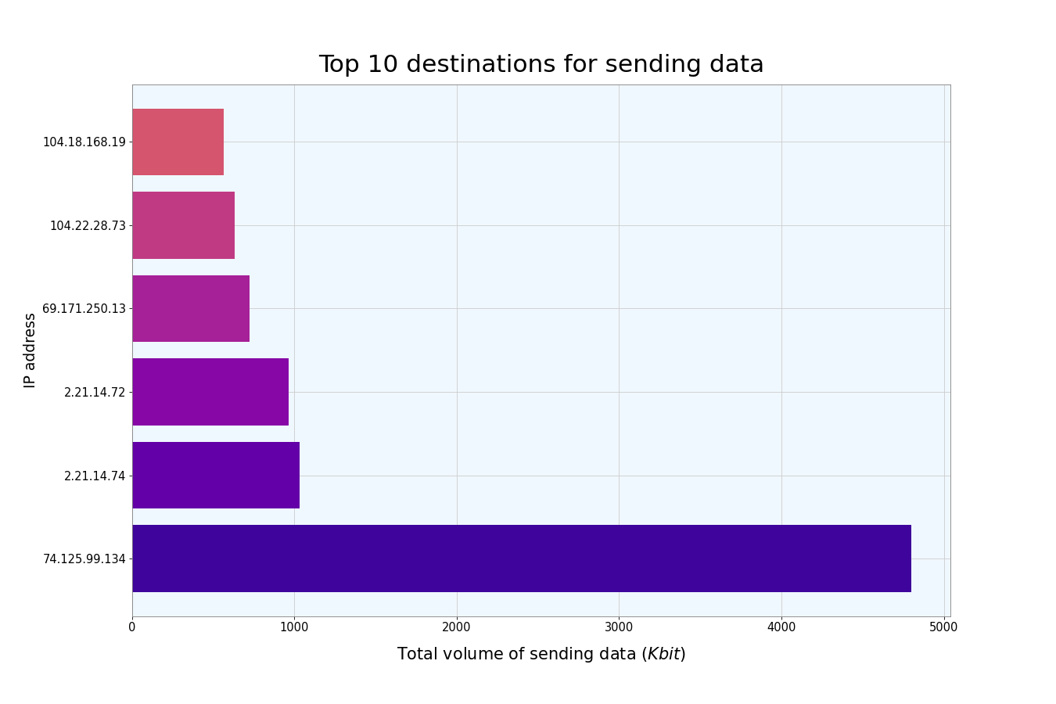
Top 6 Sender IP Addresses

Slide 47
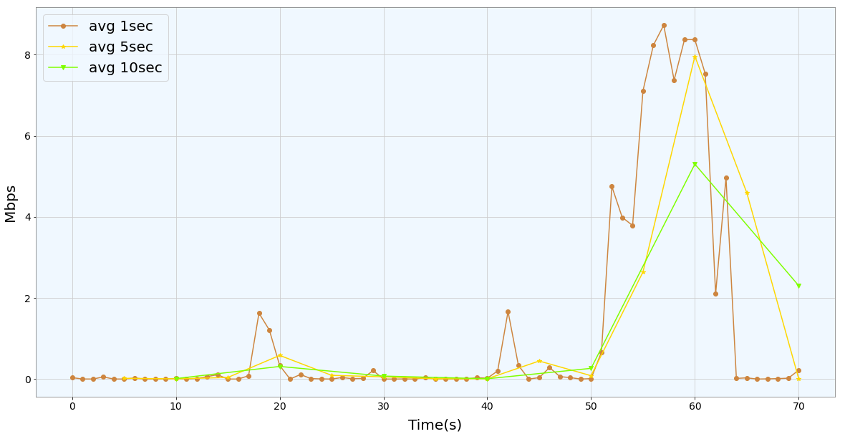
Different sampling BitRate

Slide 48
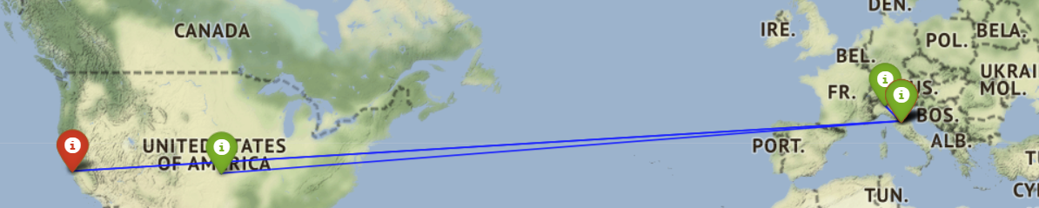
GeoLocal Referenciation
We can use ip2geotools and folium combining their properties to plot the positioning according to Latitude and Longitude of a specific IP src (i-green) and IP dst (i-red)

Slide 49
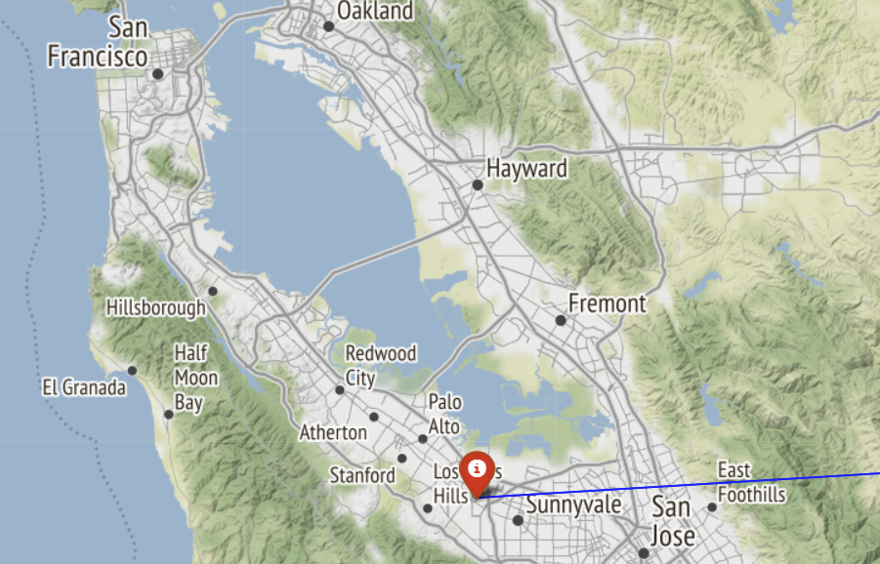
GeoLocal Referenciation

Slide 50
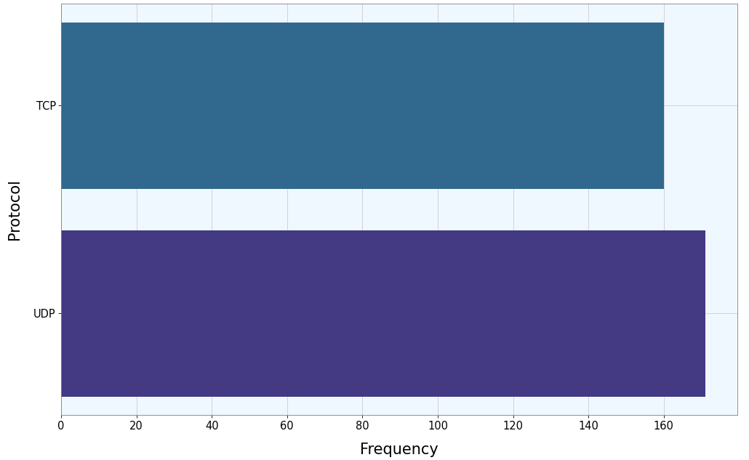
Protocol analysis based on flows

Slide 51
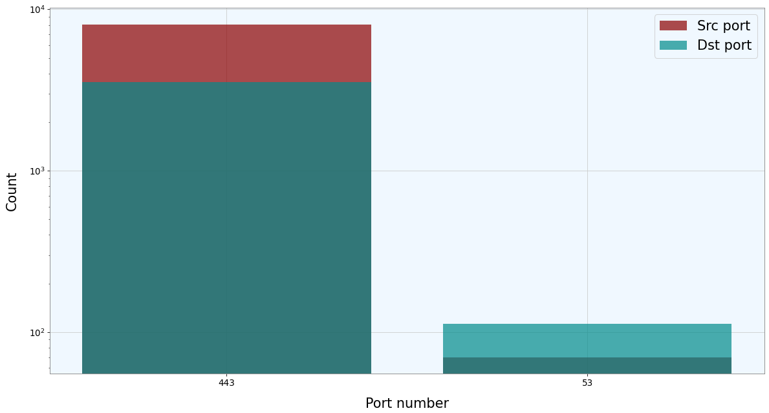
Port Scanner (just Well-Known Ports)

Slide 52
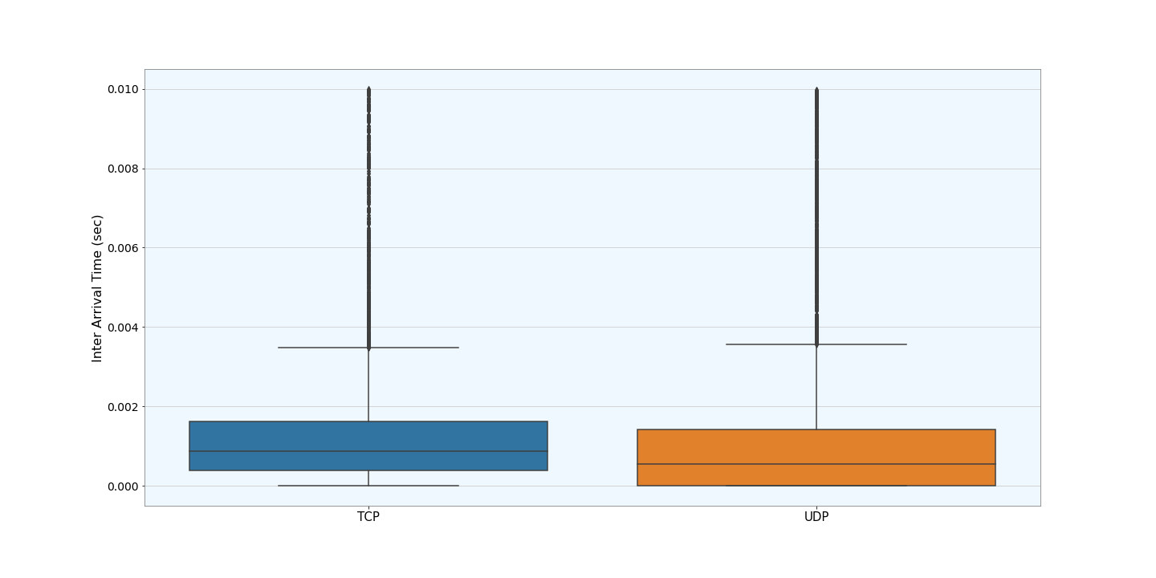
Interarrival Time difference between TCP and UDP

Slide 53
Machine Learning – Lecture 3

Slide 54
Machine Learning Project
Supervised Learning
Unsupervised Learning
Classification

Slide 55
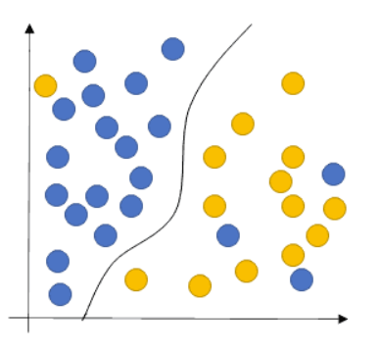
Supervised Learning
Traffic Classification based on a specific label
Our goal is to learn a function that, given a sample of data and desired outputs, best approximates the relationship between input and output observable in the data

Slide 56
Starting from Literature
Our starting point is a work implemented in 2010 :
D. Rossi, S. Valenti - ”Fine-grained traffic classification with Netflow data”
They present an algorithm (Abacus) which successfully exploits Netflow records for traffic classification. Identifying an application by means of the simple counts of received packets and bytes.

Slide 57
Classification methodology
Data:
Netflow measures flow level features
What is a flow ?
Key (5-tuple)= <IP src, IP dst, src Port, dst Port, IP Protocol>
The key identifies a record in memory, storing besides attributes like cumulative packets and bytes counters, flow starting and finishing timestamps.

Slide 58
Classification methodology
Goal: Abacus classifies application endpoints (IP0,p0), focusing the attention on UDP Traffic.
Classes: [Pplive, TVAnts, SopCast, Joost, Edonkey, BitTorrent, Skype, DNS]
The idea is based on the behavioral classification, but it is the first fine-grained classification engine identifying the traffic by the sole examination of their traffic patterns (light-weight approach)

Slide 59
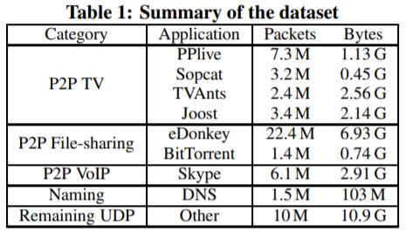
Dataset Description

Slide 60
Classification methodology
IP_{i} , p_{i}
C
IP_{i} , p_{i}
C
IP₀ , p₀
C
IP_{i} , p_{i}
ΔT
The classification is based on the raw count of packets and bytes
received by (IP₀, p₀) from the set C = {(IP_{i}, p_{i})} of N neighboring endpoints
(during an interval ∆T)

Slide 61
Classification methodology
Vector Representation:
They evaluate the distribution of «P-packets» and «B-bytes» representig them as |p| = 1 and |b| = 1
In both distributions is applied the log₂ binning, highlighting the differences for lower counts of packets and bytes
Abacus signatures s:= (p,b)
This represents the training data for the SVM algorithm

Slide 62
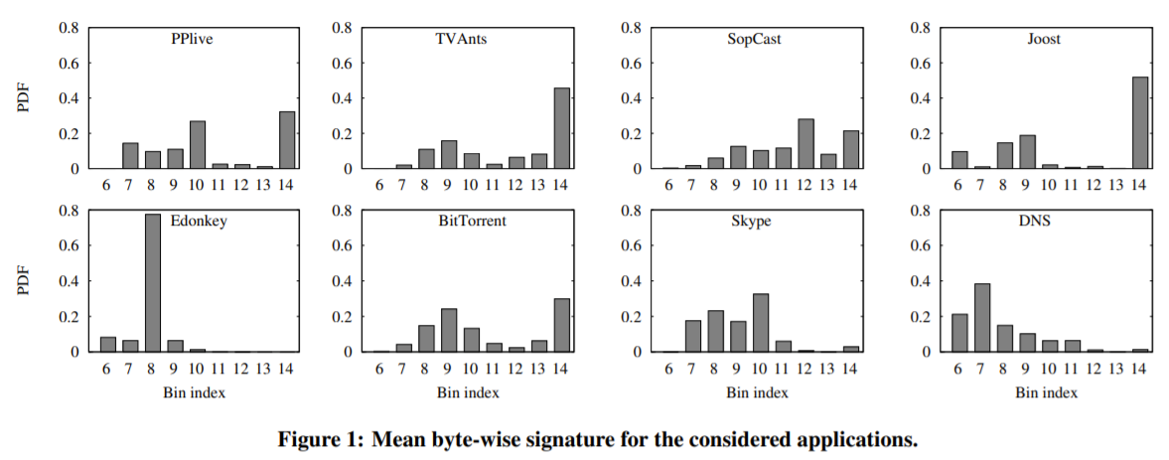
Differentiation between classes

Slide 63
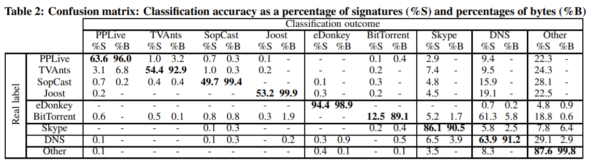
Accuracy Results
Can we replicate this proposal with our own project ?
It’s time to work …

Slide 64
Machine Learning – Code

Slide 65
Project Idea
Replicate supervised work with a different label → DSCP
DSCP stands for Differentiated Services Code Point
The architecture is called DiffServ and its purpose is to improve the QoS in IP traffic with optimal scalability.
It relies on a mechanism to classify packets as belonging to a specific service class (SC).

Slide 66
DiffServ Label
*(DS Field – 8 bits)→ DSCP(6) + ECN(2)
DSCP Value | DSCP Class | Class Label
48,56 | CS6, CS7 | Network & InterNet Control
40,46 | CS5, EF | Critical Voice RTP
32, 34, 36, 38 | CS4, AF4 | Flash Override
24, 26, 28, 30 | CS3, AF3 | Flash Voice
16, 18, 20, 22 | CS2, AF2 | Immediate
8, 10, 12, 14 | CS1, AF1 | Priority
0 | CS0 | Best Effort

Slide 67
Project Idea
In our project we exloit this label but in a summarized way:
Best Effort (BF)
Scavenger (called NotKnow in the code)
Assured Forwarding (AF)
Expedited Forwarding (EF)
Network & Internetwork control (NIC)
Dataset: https://mawi.wide.ad.jp/mawi/samplepoint-G

Slide 68
Google Colab
Link:

Slide 69
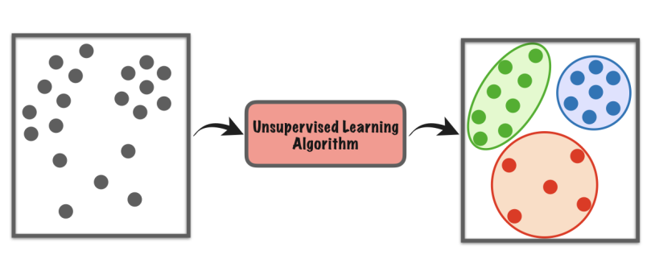
Unsupervised Learning
Traffic Classification based on unlabelled data
The model works to discover patterns and information that was previously undetected

Slide 70
Starting from Literature
Our starting point is a work implemented in 2009 :
Y. Zeng, T.M. Chen - ” Classification of Traffic Flows into QoS Classes by Unsupervised Learning and KNN Clustering”
They use K-means clustering as unsupervised machine learning methods to identify the inherent classes in traffic traces.

Slide 71
Dataset
Data: The traffic was separated into flows by the quintuplet {IP Src, IP Dst, Protocol, src-port, dst-port}
Applications: HTTP, NNTP, SMTP, FTP, DNS, telnet, SSH
Idea: Traffic flows are classified into QoS classes, flows within the same QoS class share similar service requirements

Slide 72
Variables
Candidate Feature:
• packet level: packet length statistics (max, min,μ,var);
• flow level: statistics of number of packets per flow, number of bytes per flow, flow duration, interarrival times;
• TCP connection level: statistics of packets per TCP connection, bytes per connection, connection duration

Slide 73

K-Means
K-Means finds the optimal solution by minimizing the square distance:
K:# clusters
c: # centroids
n:items
Working without «a priori» knowledge aboute the optimal number of clusters (k), it is determined by the elbow method analysis.
The optimal number of centroids minimizes the sum of distance

Slide 74
Fast view on results
Discovered 3 clusters: DNS , Telnet and FTP control, HTTP.
DNS → small avg packet size,
short connection duration time
Telnet and FTP control → small avg packet size,
long connection duration
HTTP → medium/large avg packet size,
low/medium connection duration

Slide 75
From clusters to QoS Class
In the last analysis the authors observed that the K-Means result replicate an already division of applications based on QoS requirements provided by Roughan et al[1]
[1]Roughan et al, “Class-of-service mapping for QoS: a statistical signature-based approach to IP traffic classification,”
Application | QoS Class
DNS | Transactional
Telnet and FTP control | Interactive
HTTP | Bulk transfer

Slide 76
Project Explanation
2 parti
1) Analisi di una traccia pcap (generata da loro o con mawi ?) Riformulare la parte dell’analisi statistica e possono aggiungere qualsiasi idea in più, distribuzione della lunghezza dei pacchetti, confronto TCP – UDP
2) Diamo noi il dataset 600k pacchetti loro devono scegliere se implementare supervised e confrontarsi con le matrici di rossi oppure unsupervised ed osservare come clusterizza i pacchetti

Slide 77

Thank you for your attention !
Mail: davide.aureli@uniroma1.it

